Slide 1
A user interface for landscape modelling in a virtual environment using a head mounted display
Timothy Gwynn

Slide 2
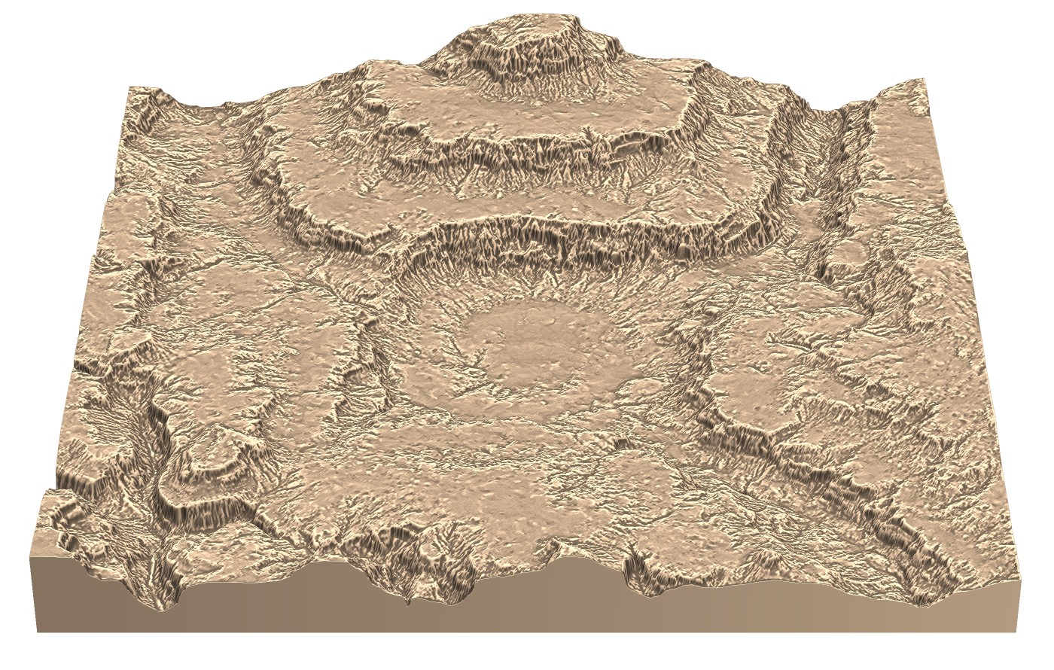
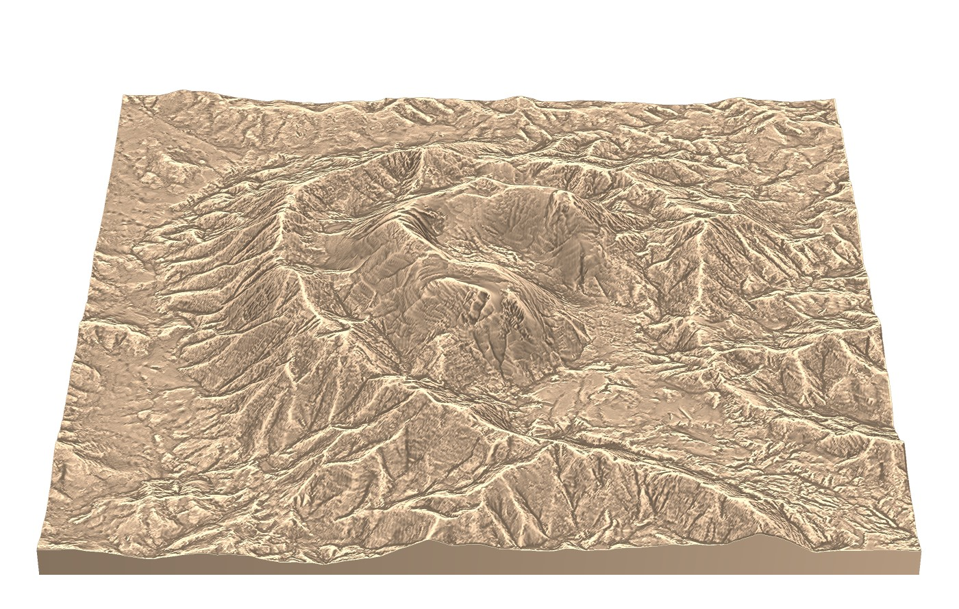
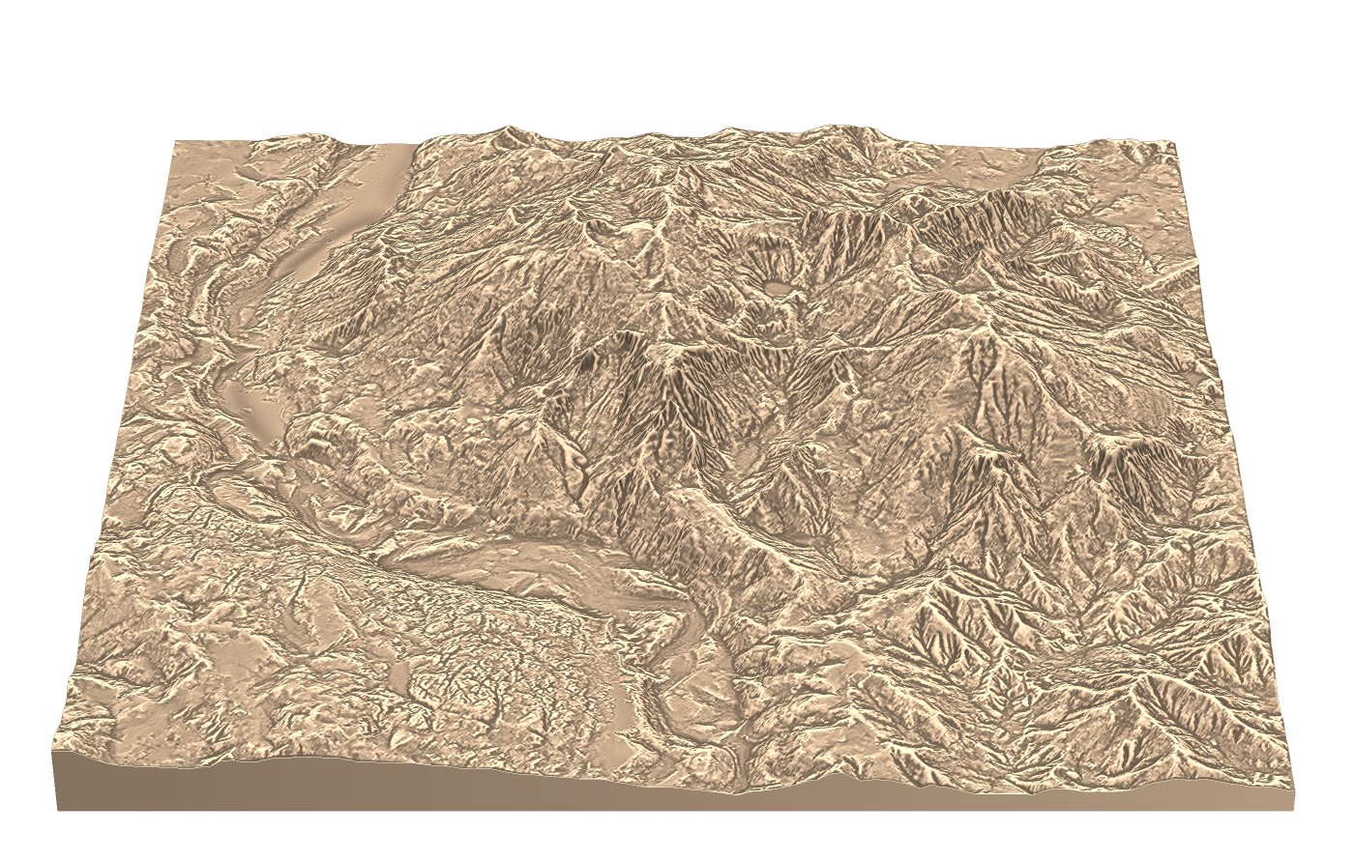
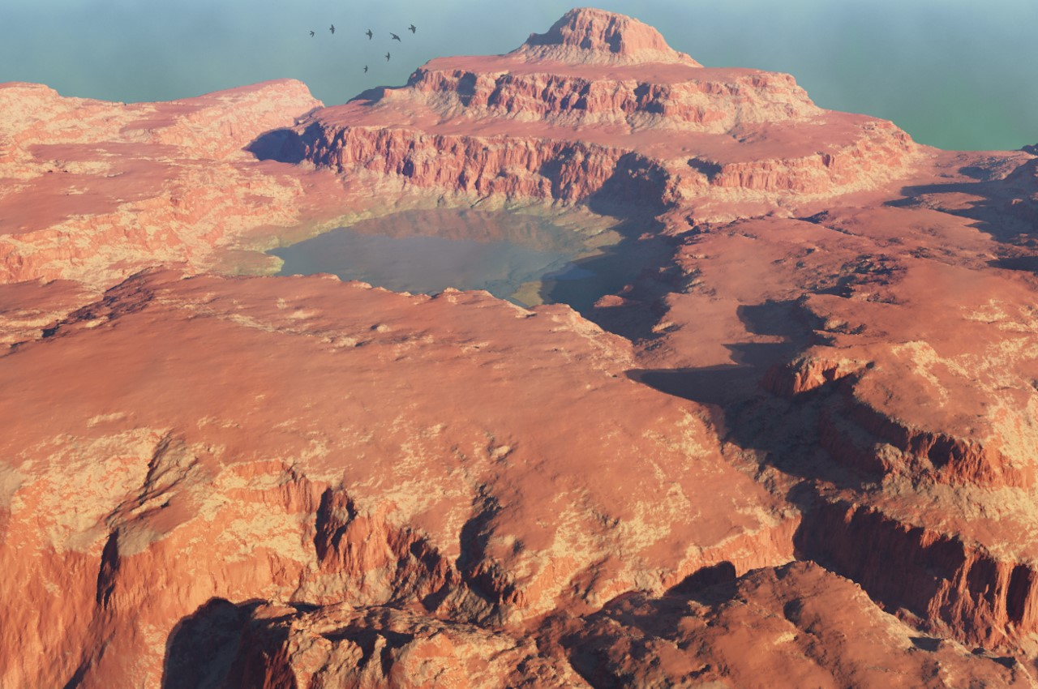
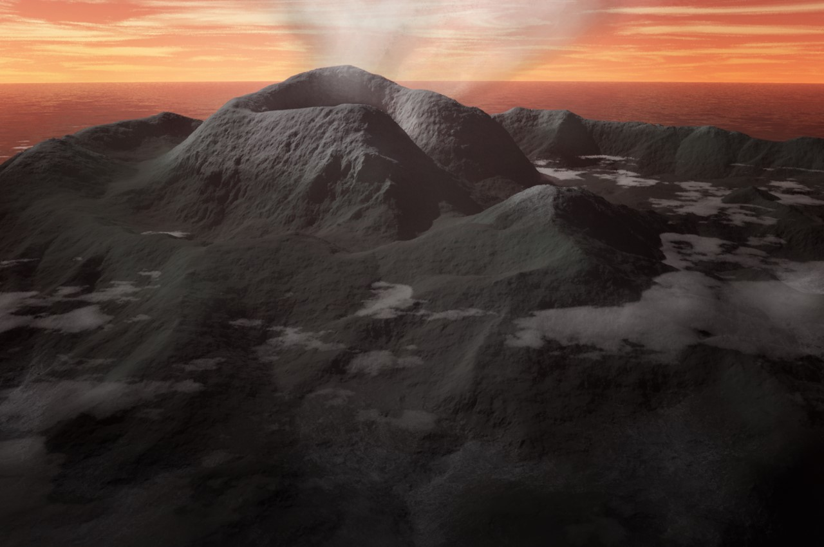
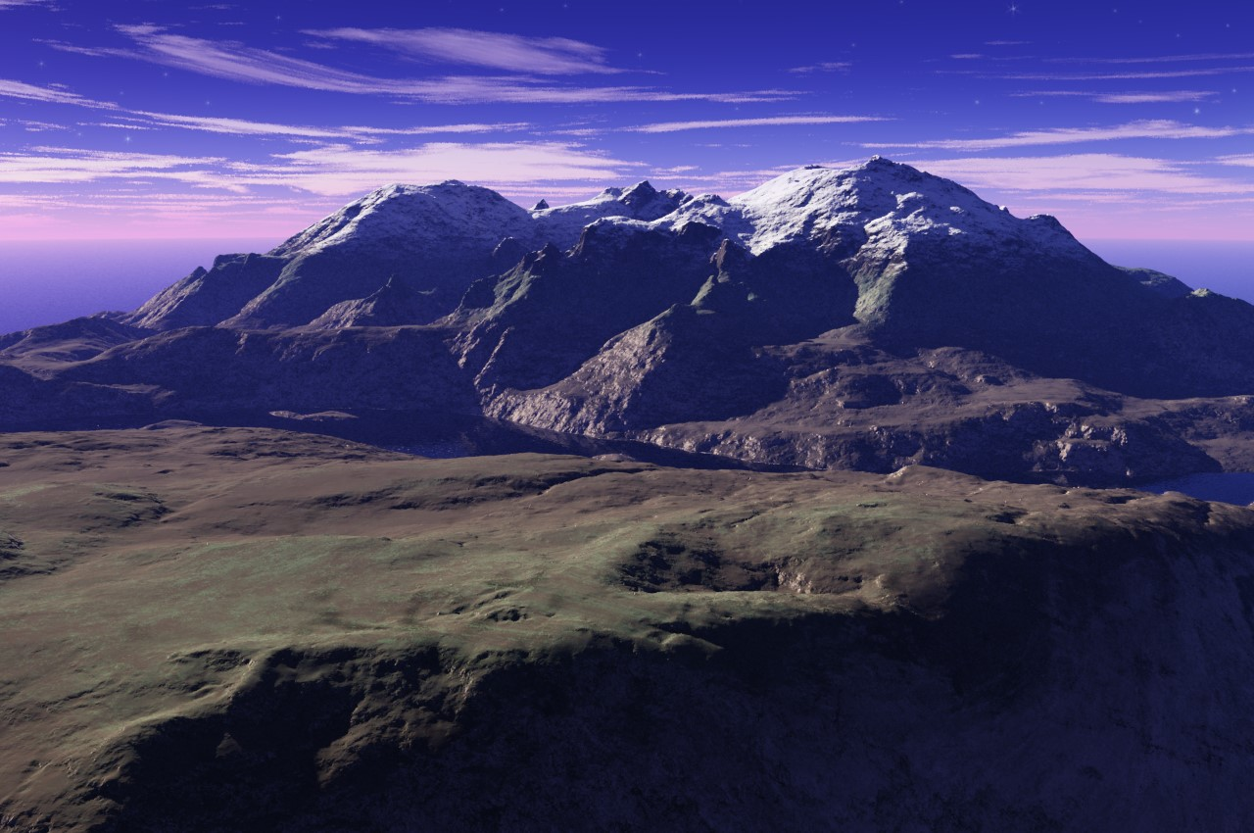
UTS
Allows for real-time editing with realistic terrain synthesis
Hybrid interface includes 3D widgets, sketching and painting
Desktop application

Slide 3
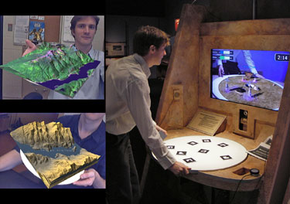
Why create a VE interface?
Allows designers to work in the same environment as users
Two handed interaction
High Bandwidth input
Large screen/ interaction space
Flow and Immersion

Slide 4
Evidence
A number of studies comparing the speed in VEs vs desktop applications
Up to 8x faster with sufficient expertise
Often very simple, general actions
Training is obviously important
Table 2. Training Times in Minutes for the Docking Study.
 | N | Min | Max | Mean | Std. Dev.
Mouse | 20 | 4 | 15 | 9.3 | 2.8
Wand | 20 | 10 | 75 | 32.6 | 17.7
THI | 20 | 20 | 120 | 47.7 | 30.5

Slide 5
VE Interface Design
3 major areas of interest
Navigation, Interface interaction and Environment interaction
Distinct but also tightly related

Slide 6
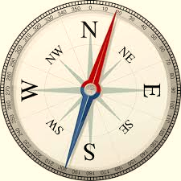
VE Interface Design - Navigation
Getting from A to B and knowing where those are
Number of methods including flying, walking and teleportation
Ways to help users – Landmarks, maps and sounds
Consider how travel is controlled by the user

Slide 7
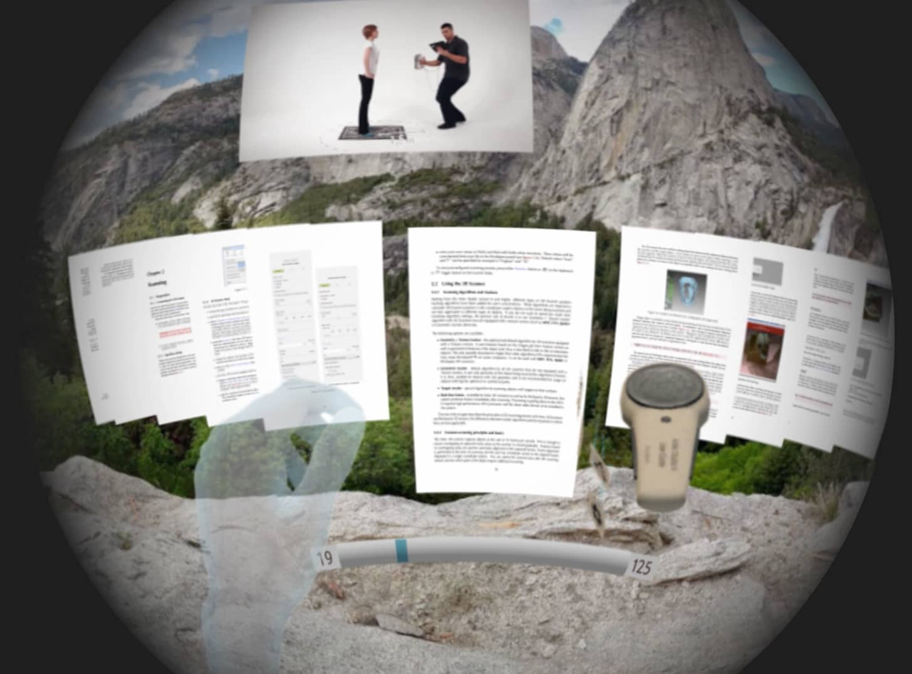
VE Interface Design – Interface Interaction
2D artifacts in a 3D world
Minimize the interface/cognitive layer
Avoid inflated DOF
Menu and widget design
User controls – Joystick, Gesture, Buttons

Slide 8
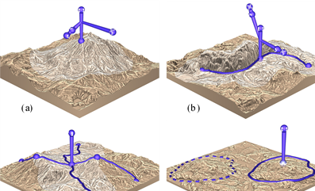
VE Interface Design – Environment Interaction
Handling Depth – Go-Go hand or Raycasting (AAAD)
Bring the world to you
What works with free floating controls – Sketching and Painting

Slide 9
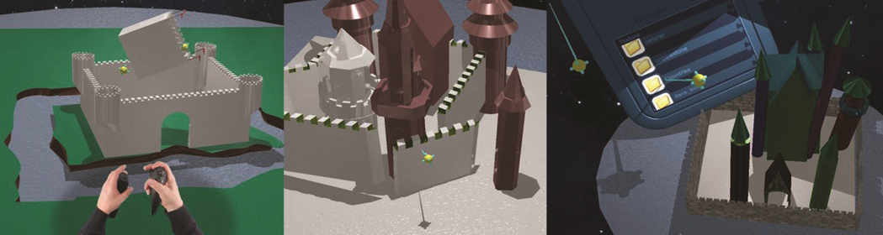
Similar Applications
They exist, albeit using different hardware
Often 1 handed or using custom devices
Small scale, informal or no usability testing
Majority are CAD based

Slide 10
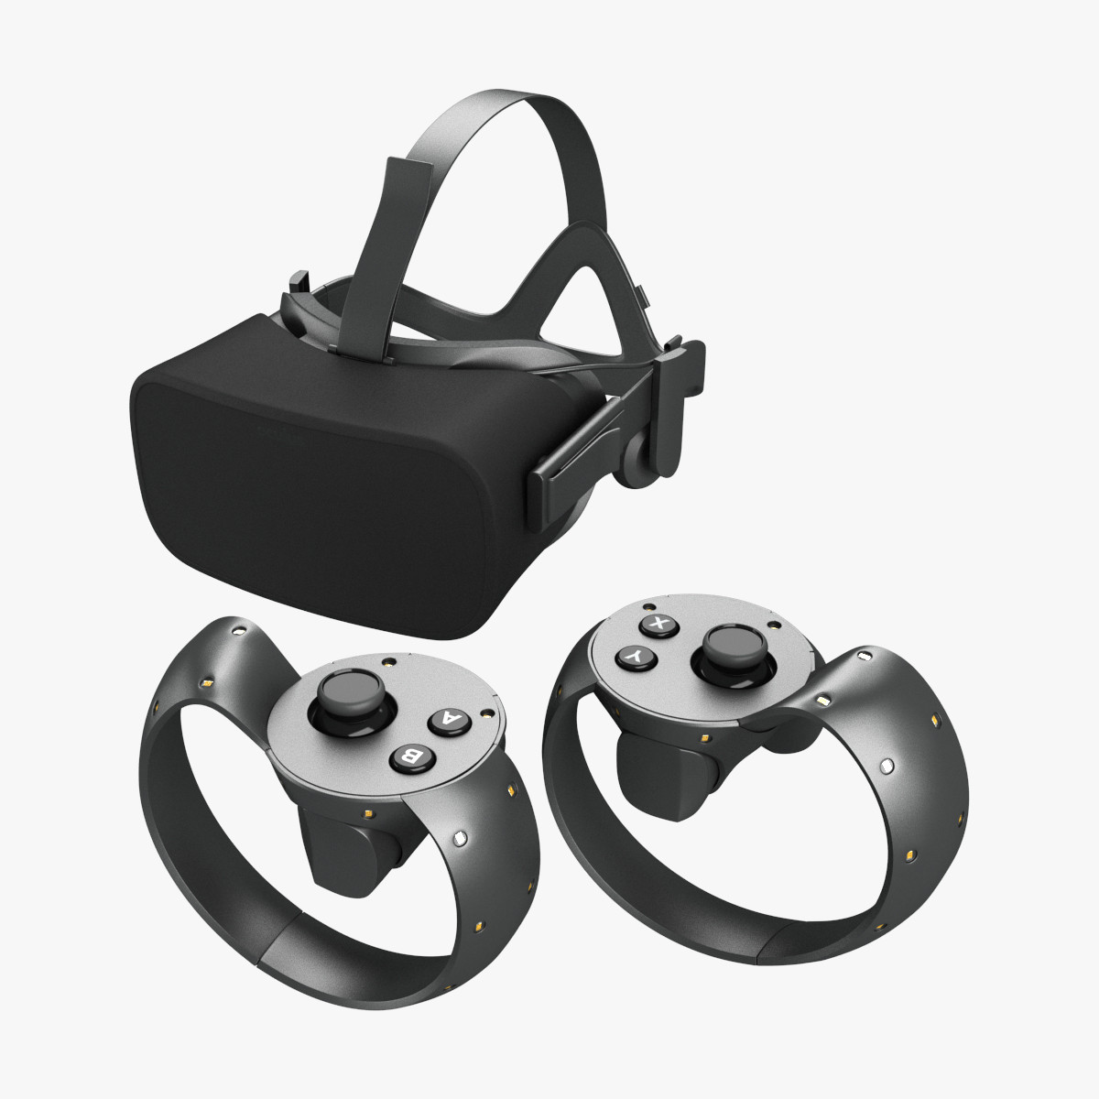
My Design Ideas
Hardware – Oculus Rift + Oculus touch controllers
Software – Hopefully interface design can be done in Unity 3D
Core philosophies – Prioritize user comfort, utilize natural gestures, Provide shortcuts for experienced users, Design with developer environment in mind

Slide 11
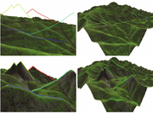
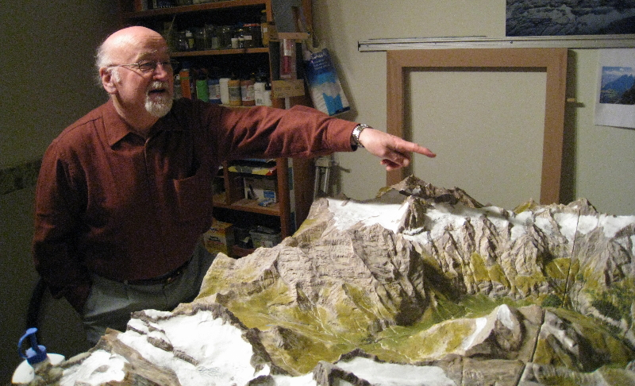
Dual Modes
Allow users to switch between a scene-in-hand god view and an immersive FPV
Allow for quick terrain modeling as well as getting a sense of user experience
Switching between views must be quick but avoid disorientation
Modes must complement each other

Slide 12
Terrain Modelling
Mostly in god-view using widgets and painting
Allow sketching in FPV
Two-Handed widget manipulation
Software support for smooth sketching

Slide 13
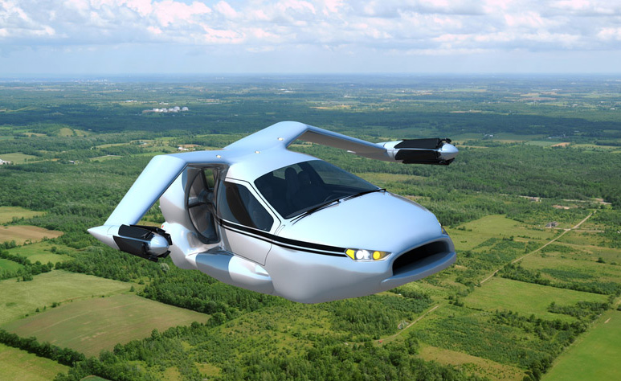
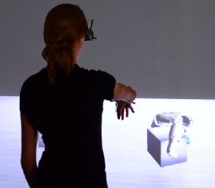
Viewpoint Manipulation
Scene-in-hand for God view
Joystick controlled flying in FPV
In general try keep movement and interaction tasks on separate hands
Model on the fly?

Slide 14
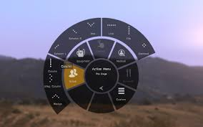
Solving the interface problem
Combination of joystick, button and gestures
Joystick for navigating menus, button for selecting (Joystick press)
Gestures for shortcuts, possibly combined with button presses
Example: Trigger and button lets you grip objects, extending index finger puts you in sketch mode
Some devoted buttons

